Slide 1
Mock API
Rest-api-client
- TLI (Tests)
Rest APIs
Real IoT-Backend
Create, configure, deactivate:
Facilities,
System controls,
Datapoint values,
Time programs,
EMF data
<<Tomcat>>
Backend core
<<Springboot>>
Comm-gateway
<<RabbitMQ>> Broker
Management API
Mocked Gateway API (VR920)
Diagnose
Emf
Scan manager
TLI
VRC720,
HMU,
BMU
…
Quick
Modes
OTX -Jobs
Status
Online/Offline
Capabilities
Ack, Nak and Error
RbR
Spine
Zones/Circuits
Ventilation
Solar
Cooling
DHW Circuit

Slide 2
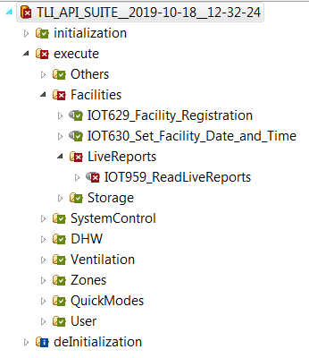
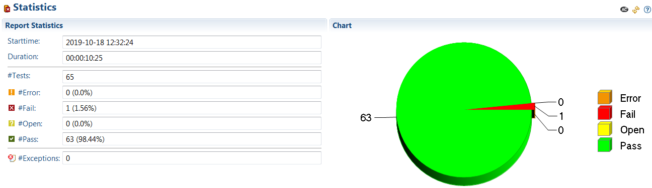
Exam Automotive tests

